Slide 1

A Tutorial on QUIC
Task 6.3HD: My Awesome Tutorial
Deakin university
Sit202 – computer networks and communication
Student’s name: Bao Minh Tran
Student’s ID: s224236373

Slide 2

OVERVIEW

Slide 3

QUIC, or Quick UDP Internet Connection, was originally developed by Google and standardised by IETF as the transport protocol for HTTP/3.
What is QUIC?
Why is QUIC essential for modern networks?
Its Key functionalities and certain Frame Formats
QUIC 1-RTT Handshake
QUIC Analysis using Wireshark
Its benefits and setbacks compared to existing protocols for the same functionalities
Current Network applications using QUIC
Potential security risks and measures
Scalability
Conclusion & Discussion

Slide 4

What is QUIC?

Slide 5
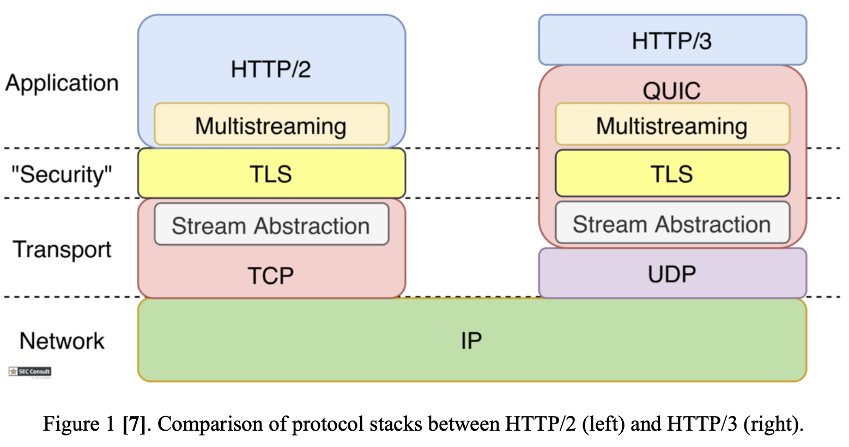
RFC 9000 stated that QUIC offers “flow-controlled streams for structured communication, low-latency connection establishment, and network path migration”.
QUIC adopted and improved the key features from:
HTTP/2
TCP
TLS
Built on top of UDP port 443,

Slide 6
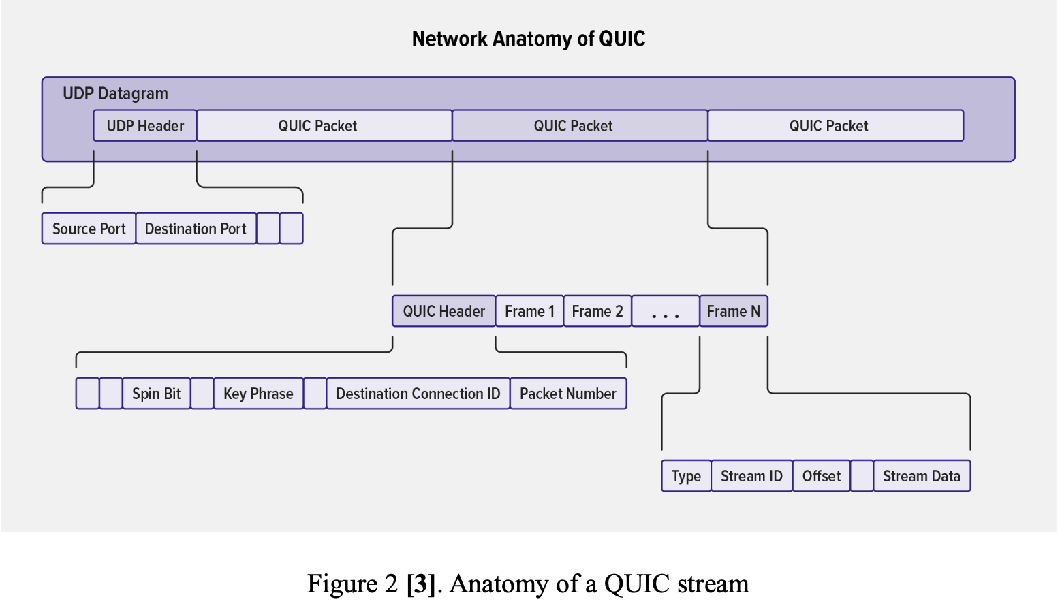

Slide 7
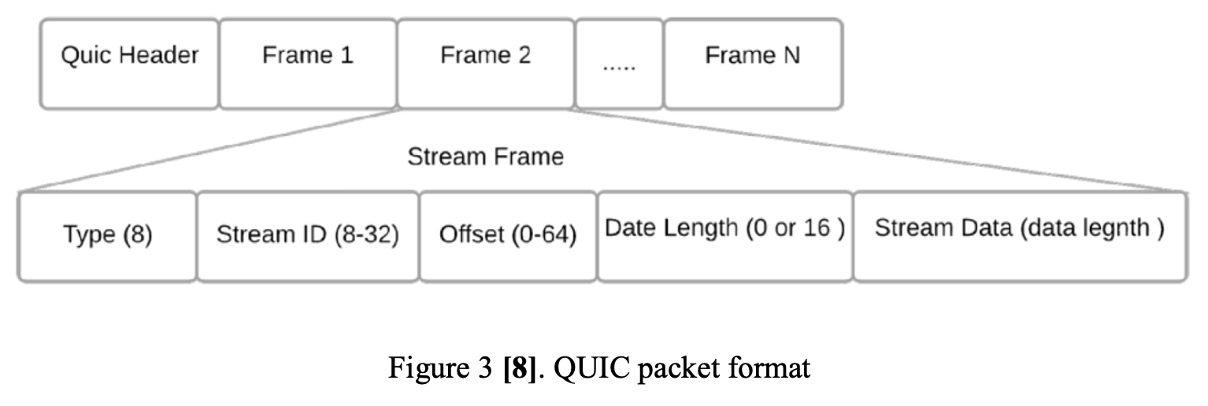

Slide 8
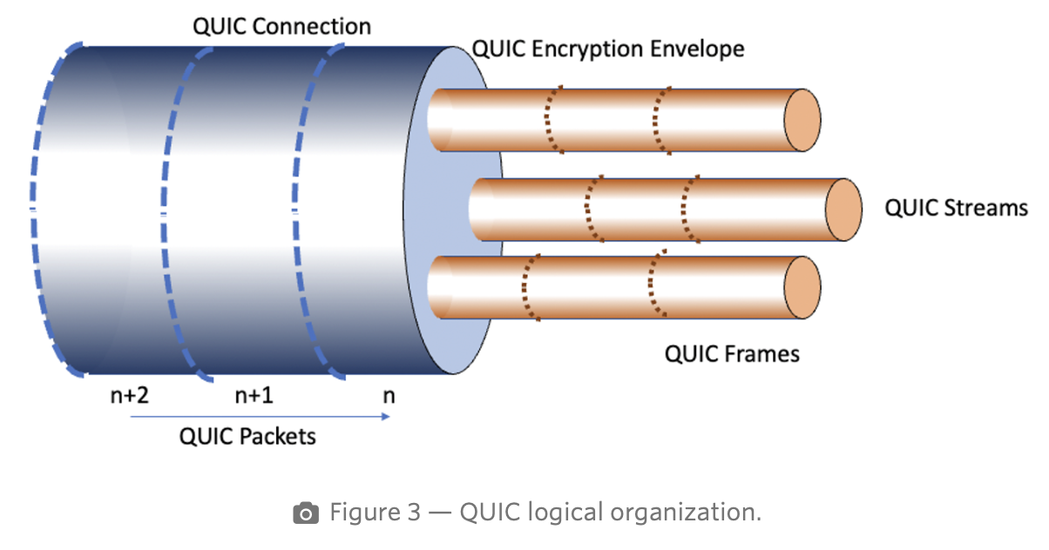

Slide 9
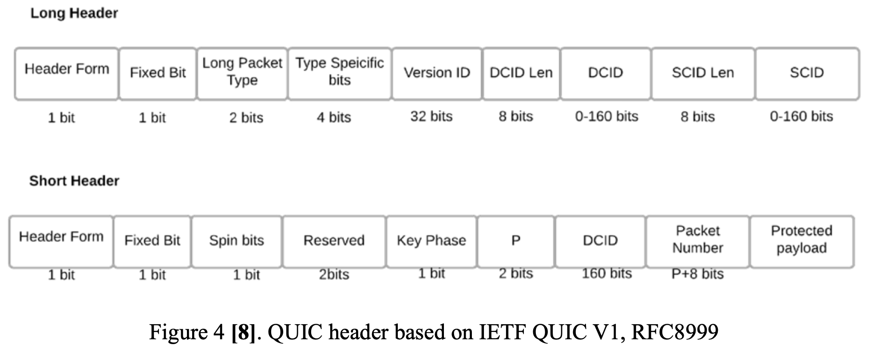

Slide 10

Why is QUIC essential ?

Slide 11
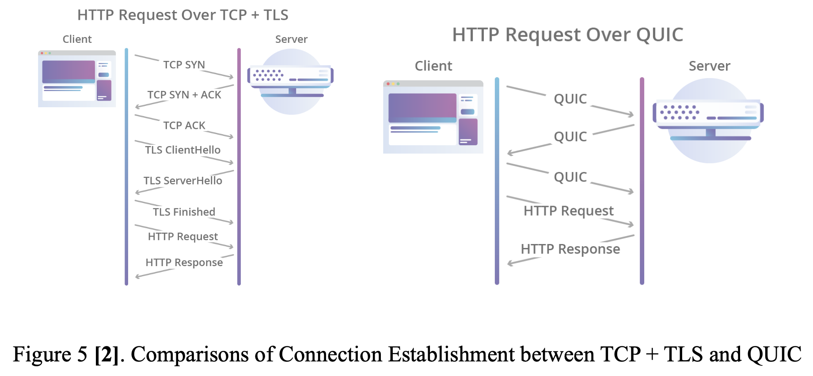
1. Lower Connection Latency

Slide 12
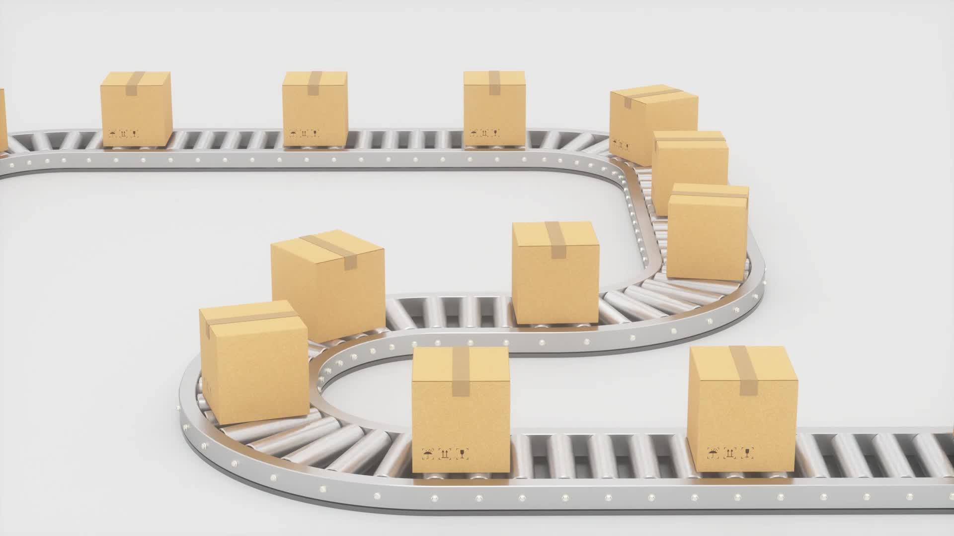
2. Reliable data delivery

Slide 13
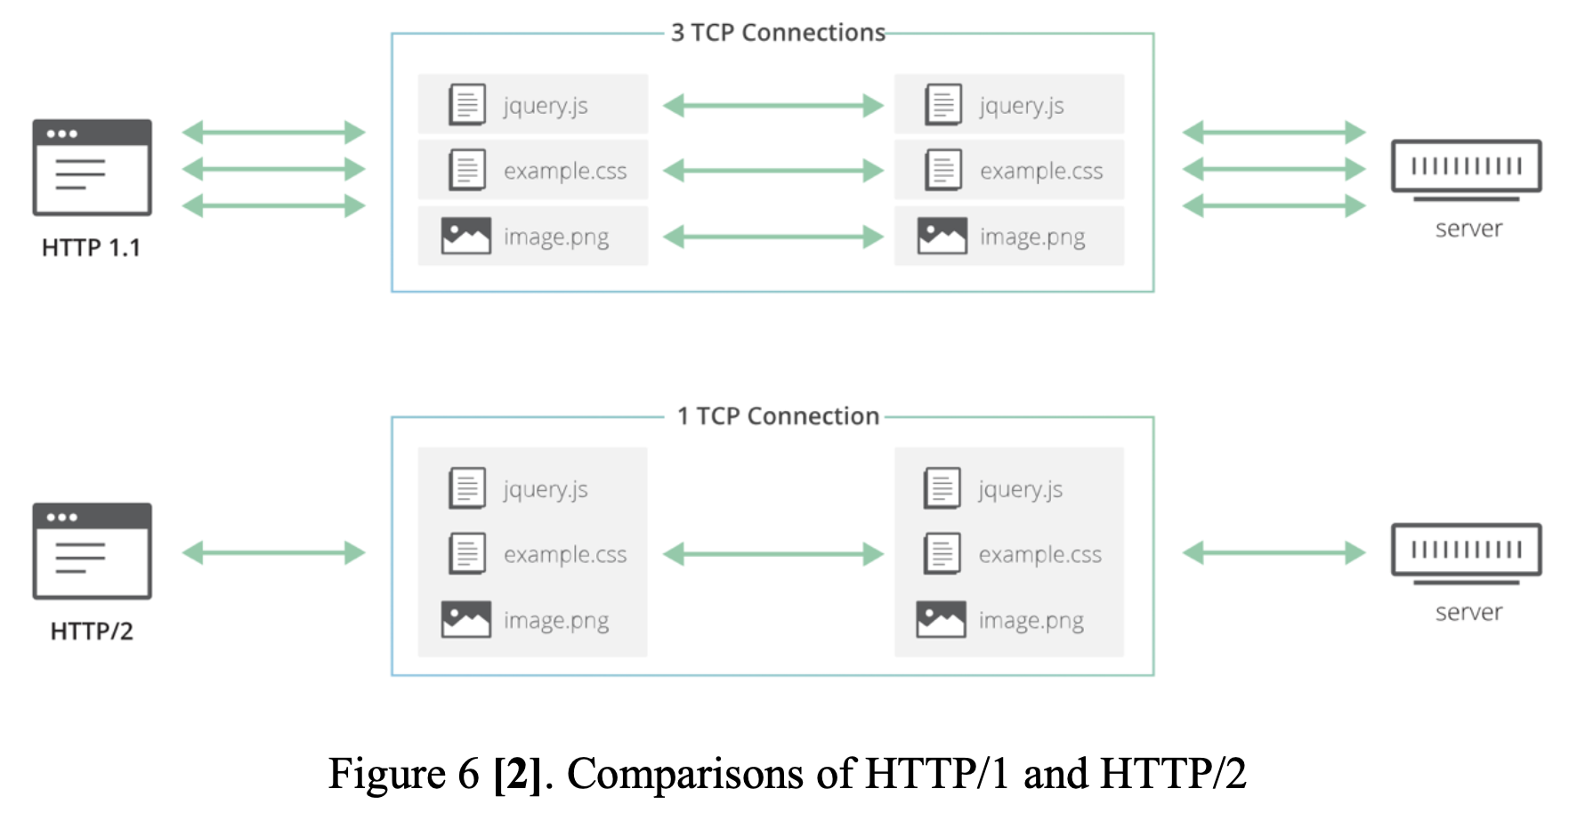
3. Head-of-Line (HoL) blocking Avoidance

Slide 14
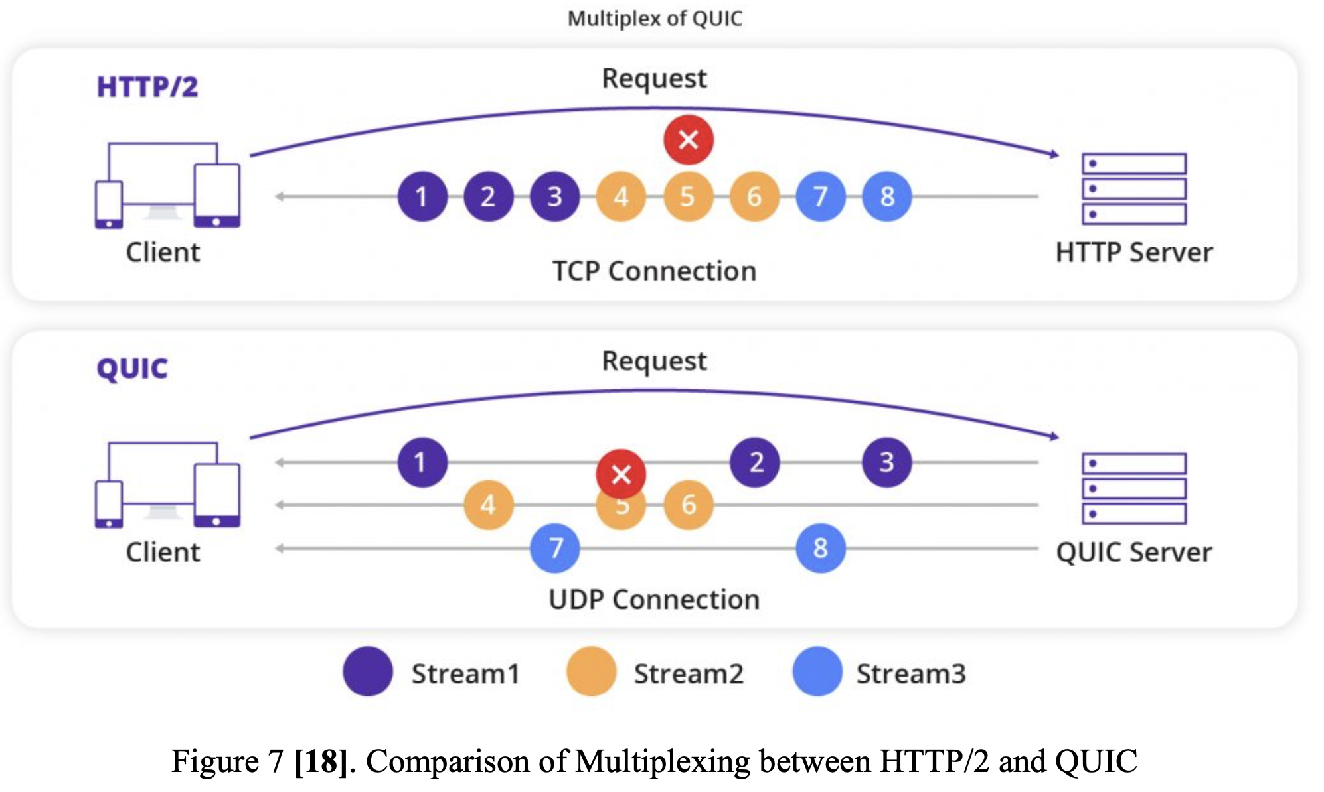

Slide 15
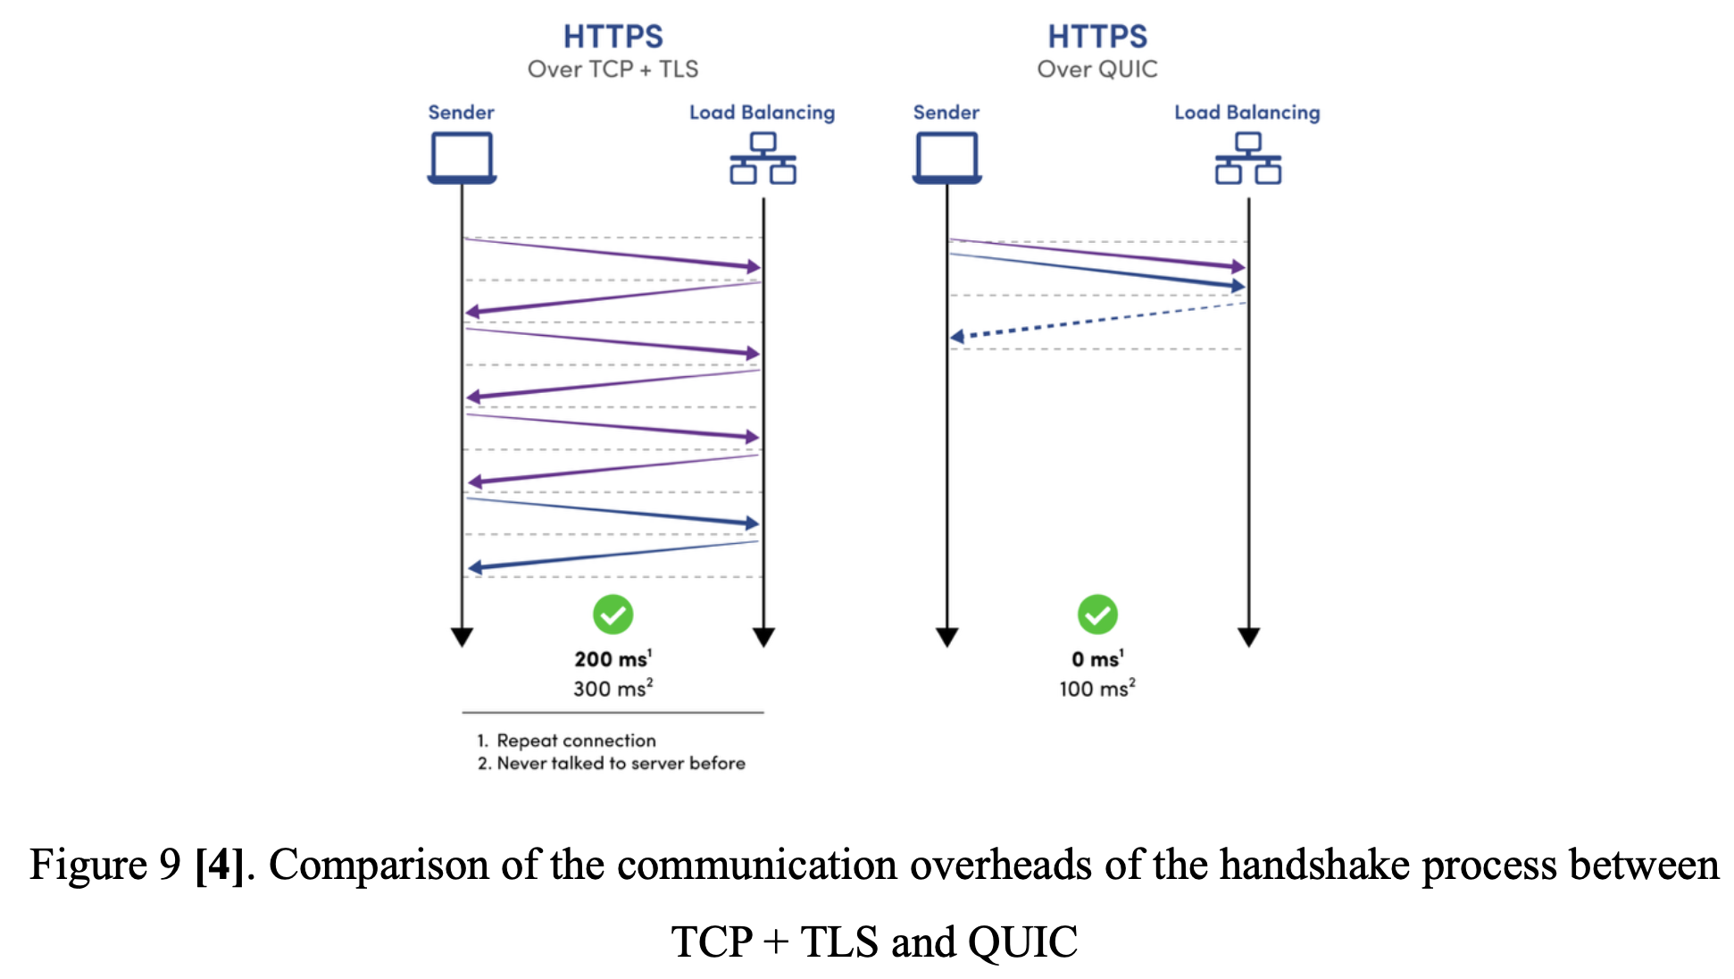
4. Connection Migration

Slide 16
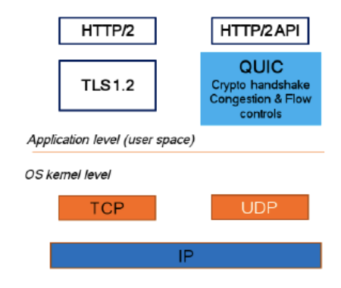
5. Streamlined Protocol Evolution

Slide 17
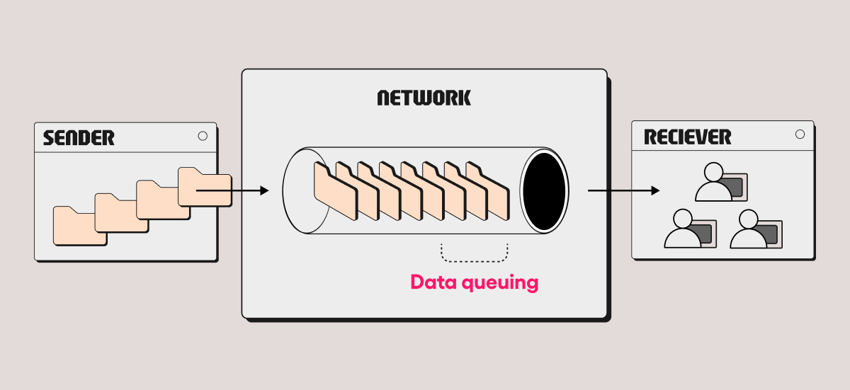
6. Performance in Congested Network

Slide 18

Functionalities & Frame Formats

Slide 19
Functionality
Reliable and ordered data delivery
congestion control
integrated security
Fast connection setup
Multistreaming
flow control
Connection Migration and Management
Error Handling
Efficient Retransmission of Lost Packets
Address Validation

Slide 20

Frame Formats

Slide 21

PADDING frame
Purpose: increase the size of the packets in the Frame to avoid potential attacks, e.g. Amplification attack.

Slide 22
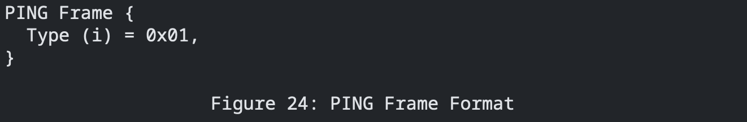
PING frame
Purpose: verify the liveliness of the QUIC connection.

Slide 23
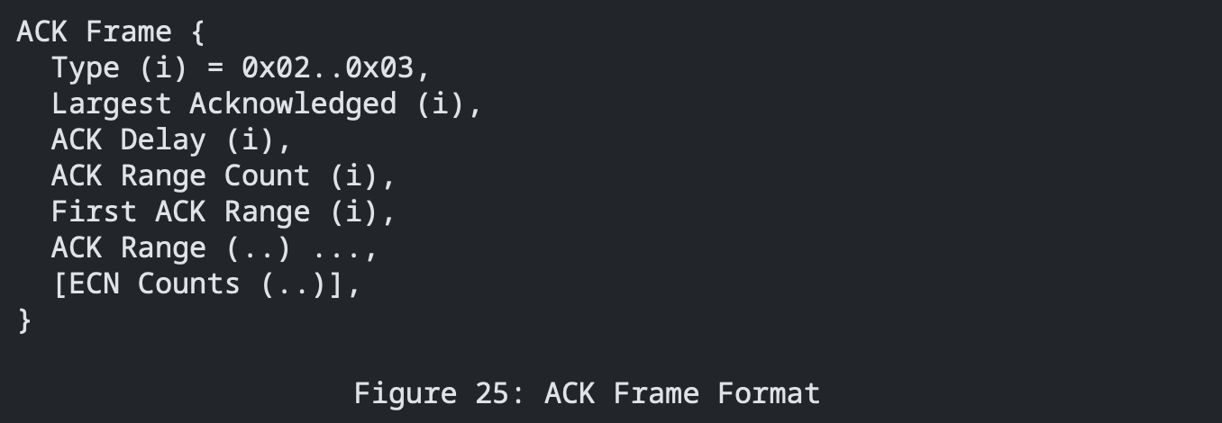
ACK frame
Purpose: similar to Selective ACK (SACK) in TCP.

Slide 24
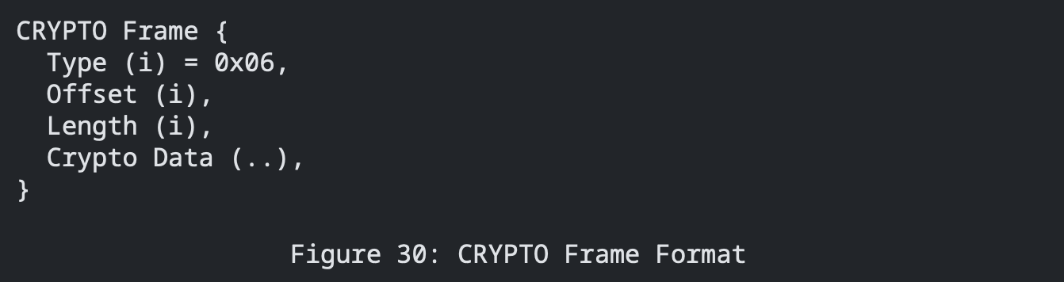
CRYPTO frame
Purpose: carries the TLS handshake messages during connection setup

Slide 25
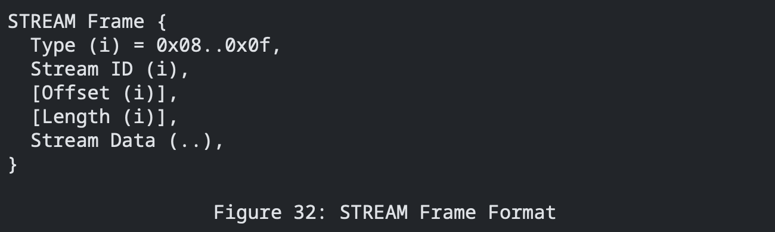
STREAM frame
Purpose: initiates a stream of data and transmits the application data for that stream.

Slide 26
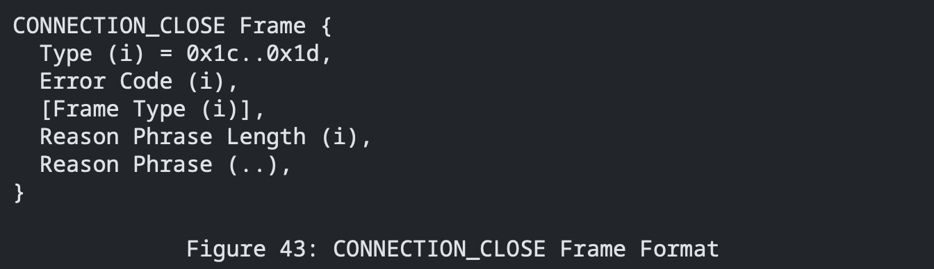
CONNECTION_CLOSE frame
Purpose: used to terminate a QUIC Connection, can be sent by both endpoints advertently or due to unexpected errors.

Slide 27
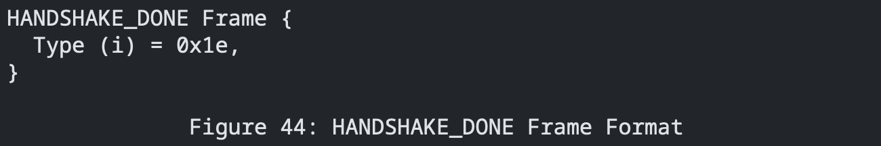
HANDSHAKE_DONE frame
Purpose: designed solely for the server to notify the clients about the confirmation of the Handshake.

Slide 28

QUIC 1-RTT Handshake

Slide 29
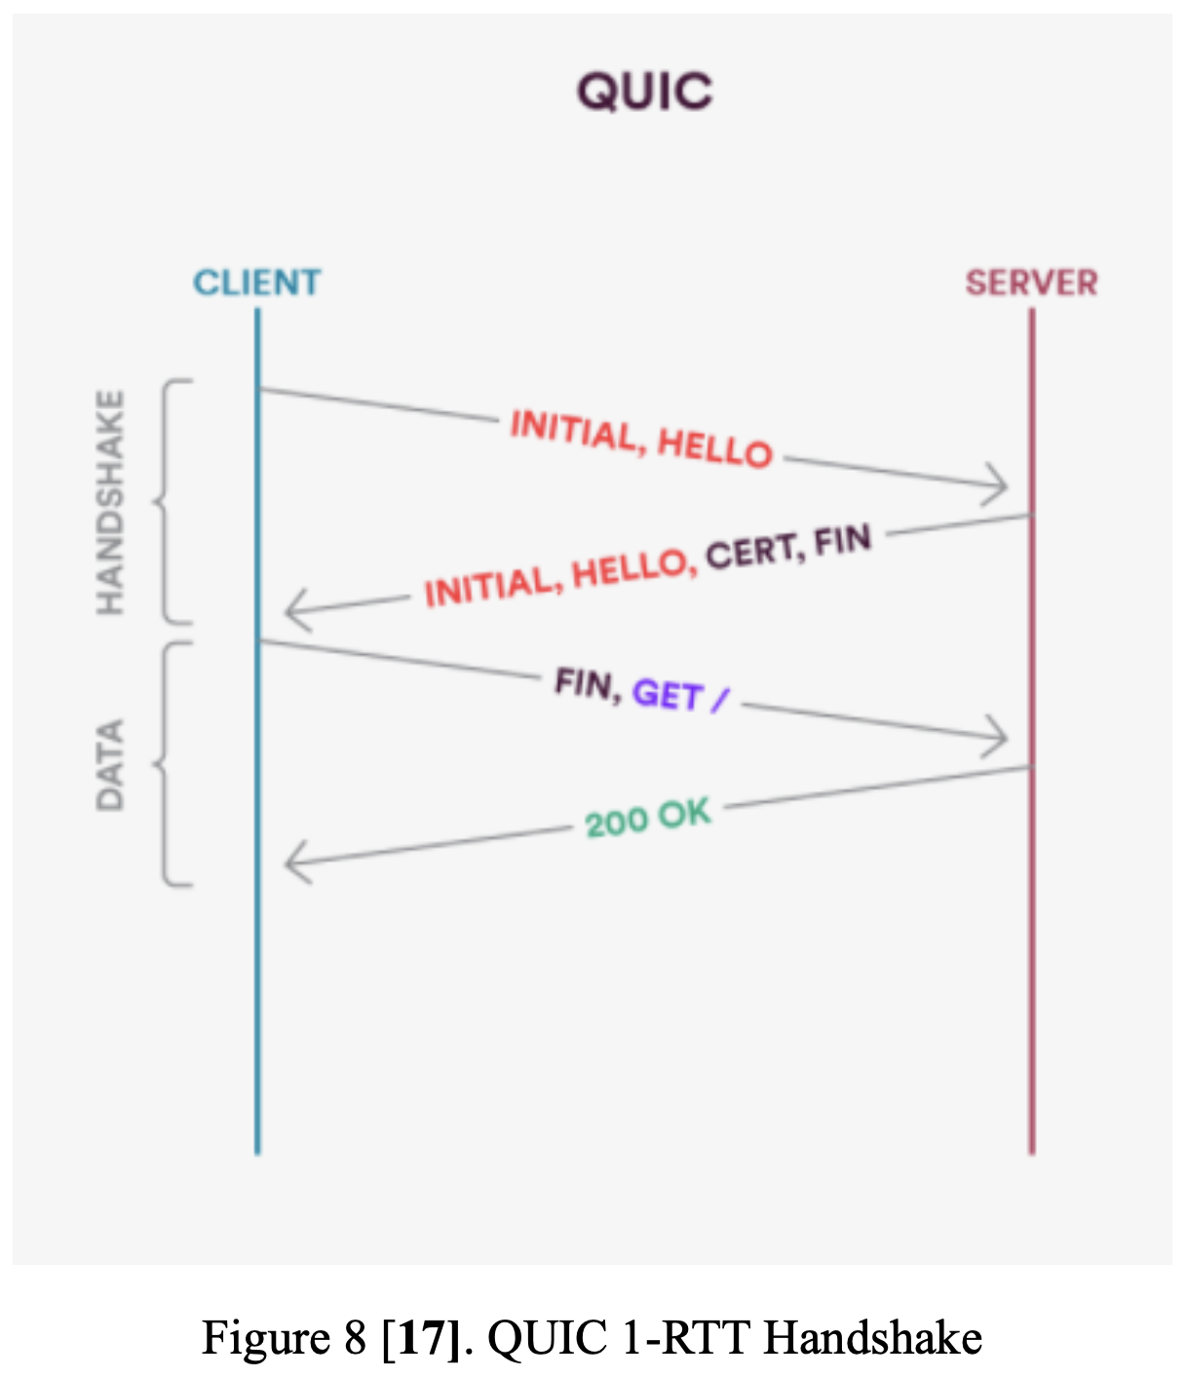

Slide 30
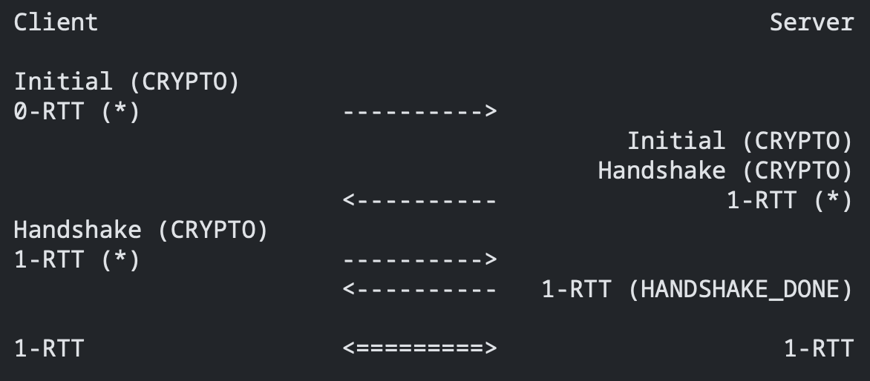

Slide 31
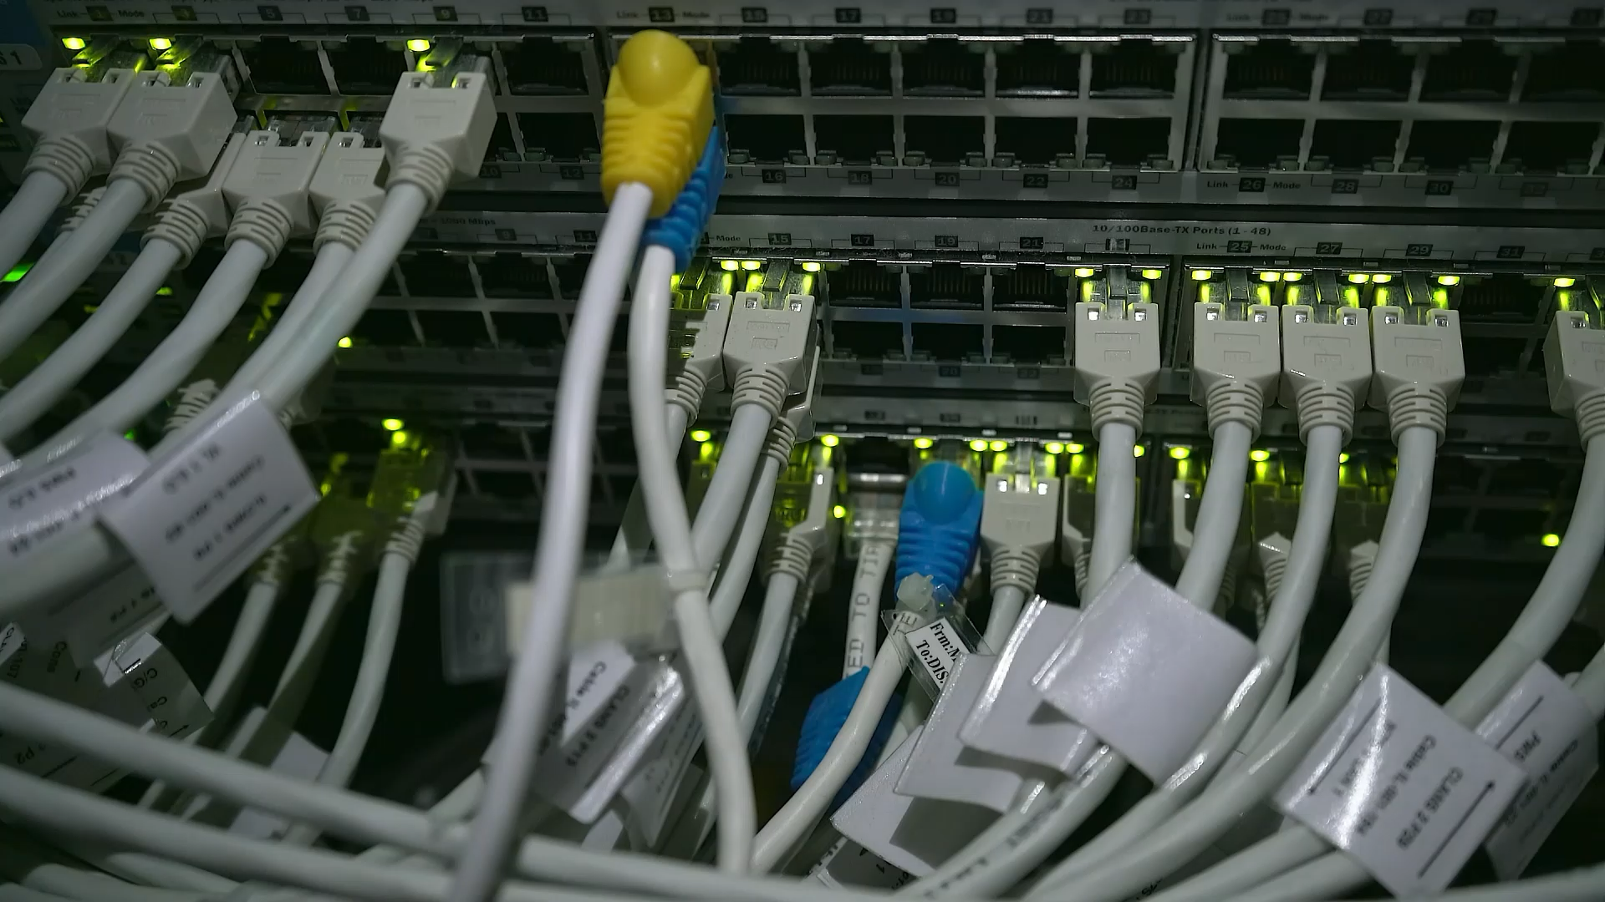
Hands-on QUIC analysis using Wireshark

Slide 32

Pros and Cons over UDP + TCP/TLS + HTTP/2

Slide 33
Advantages
Fast Connection Establishment
01
HoL Blocking Avoidance
02
Robust security by default
03
Smooth Connection Migration
04
Improved Packet Loss Retransmission
05
Adaptable to new optimisations and better Error reports
06

Slide 34
Disadvantages
Network Infrastructure Incompatibility
Ambiguity for Network Monitoring
High Computation Cost

Slide 35

Network applications using QUIC

Slide 36
Network Applications using QUIC
Web Browsing (HTTP/3)
Video and Media Streaming
DNS over QUIC (DoQ)

Slide 37

Security threats & Solutions

Slide 38
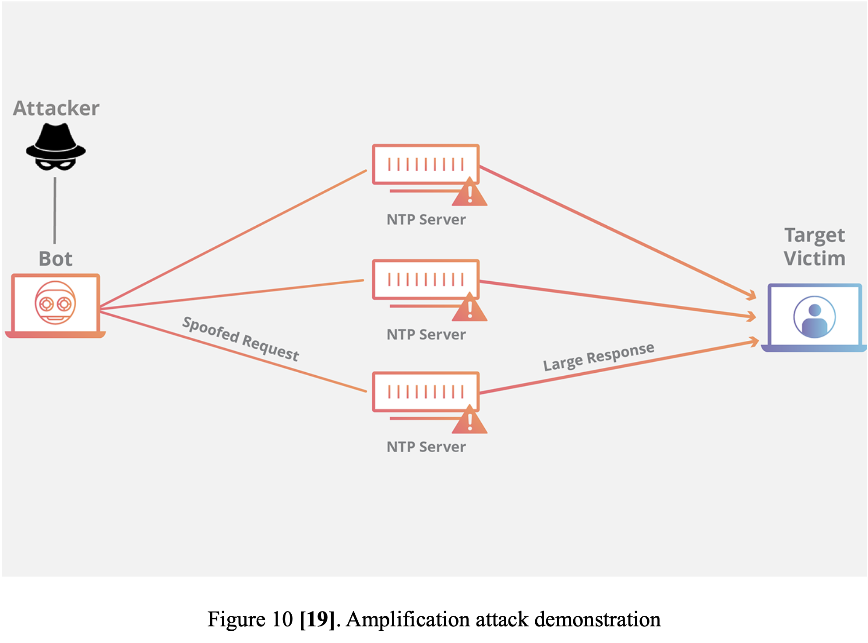
Amplification Attack

Slide 39
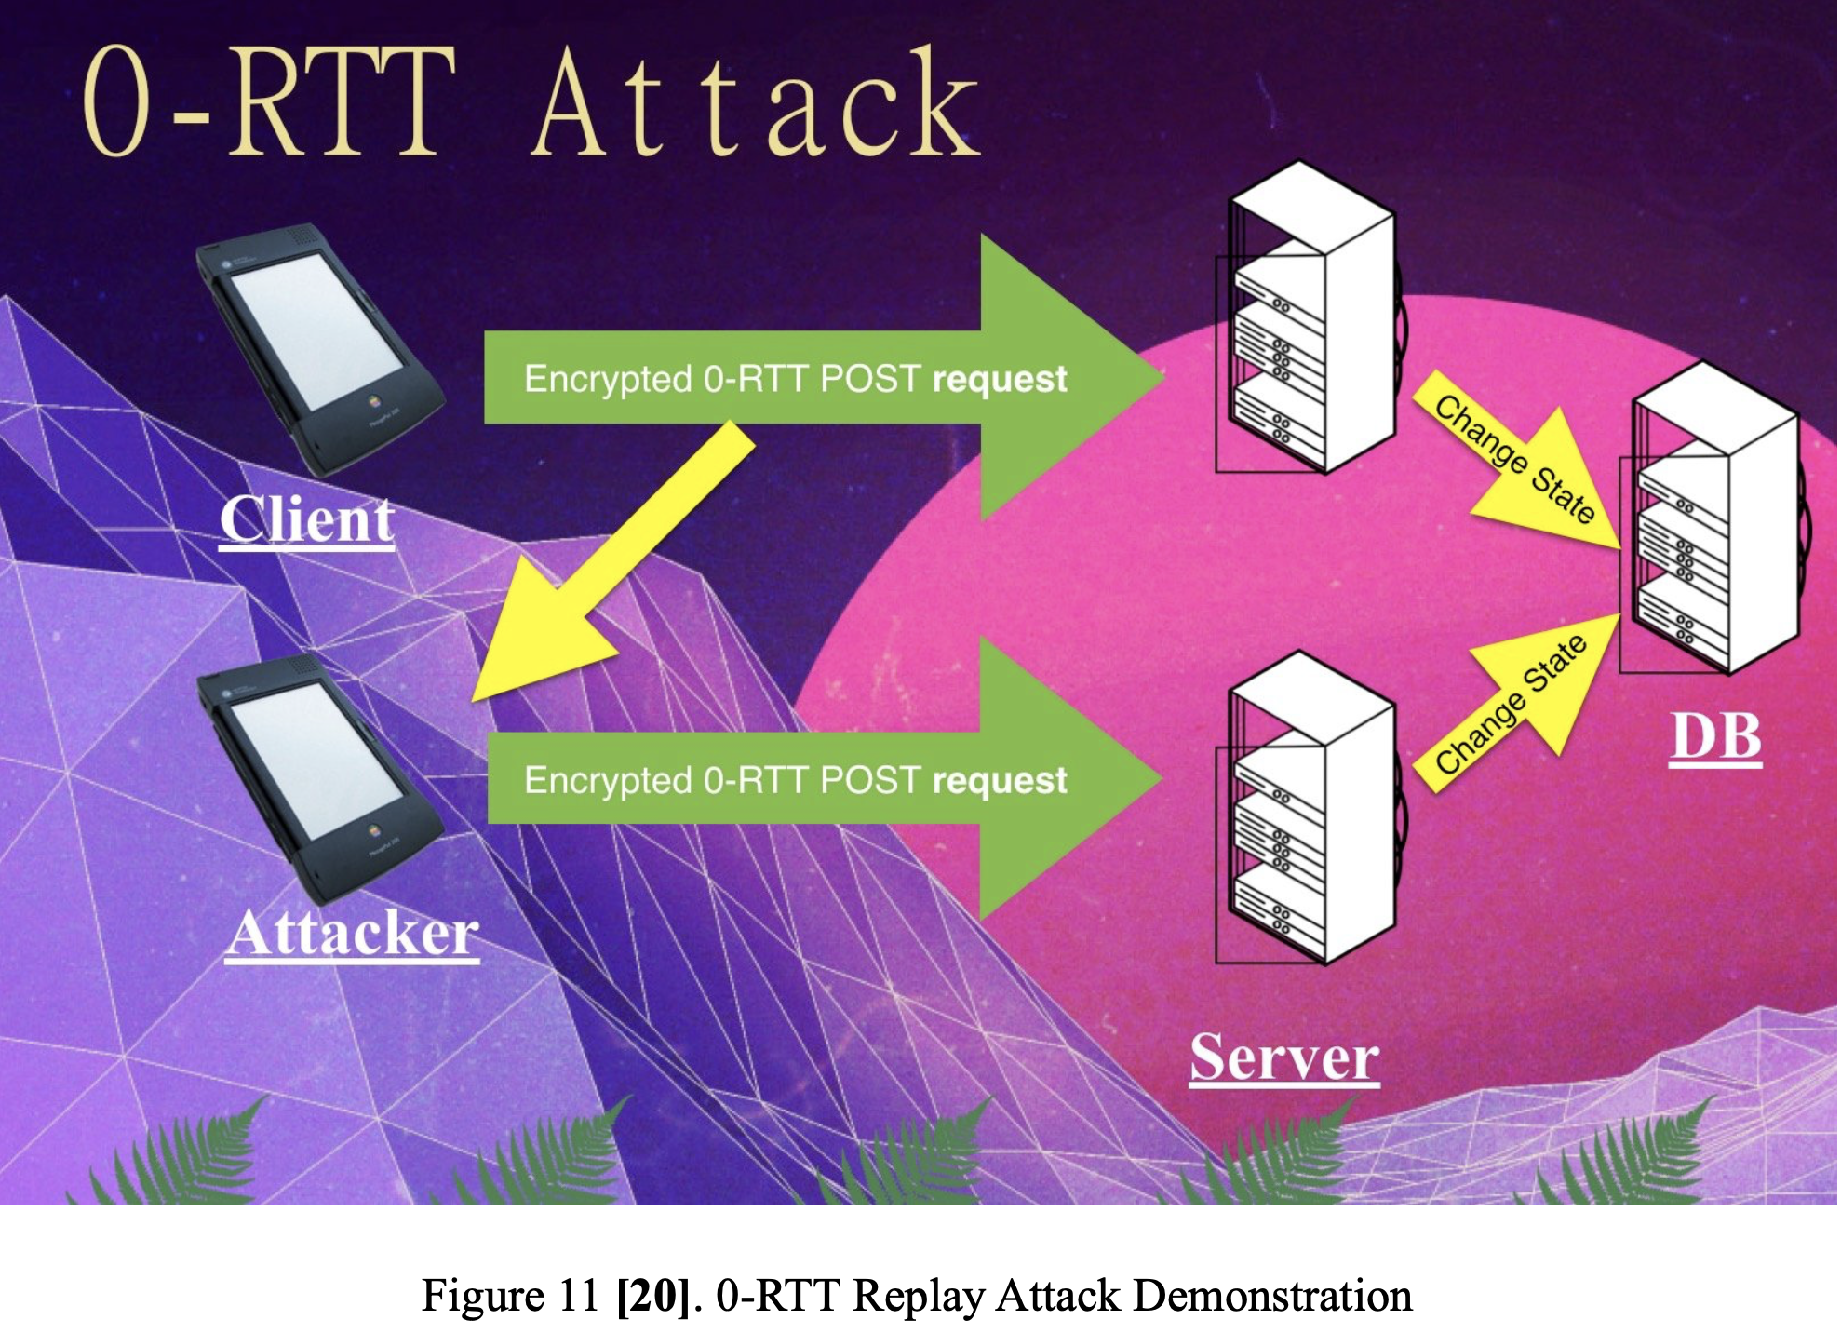
0-RTT Replay Attack

Slide 40
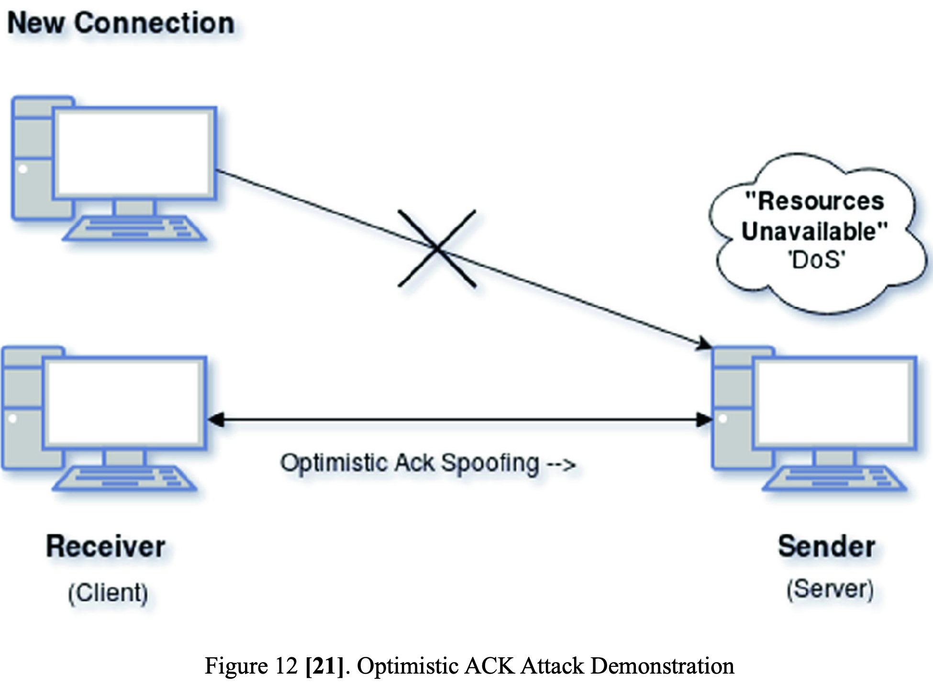
Optimistic ACK Attack

Slide 41

Scalability

Slide 42
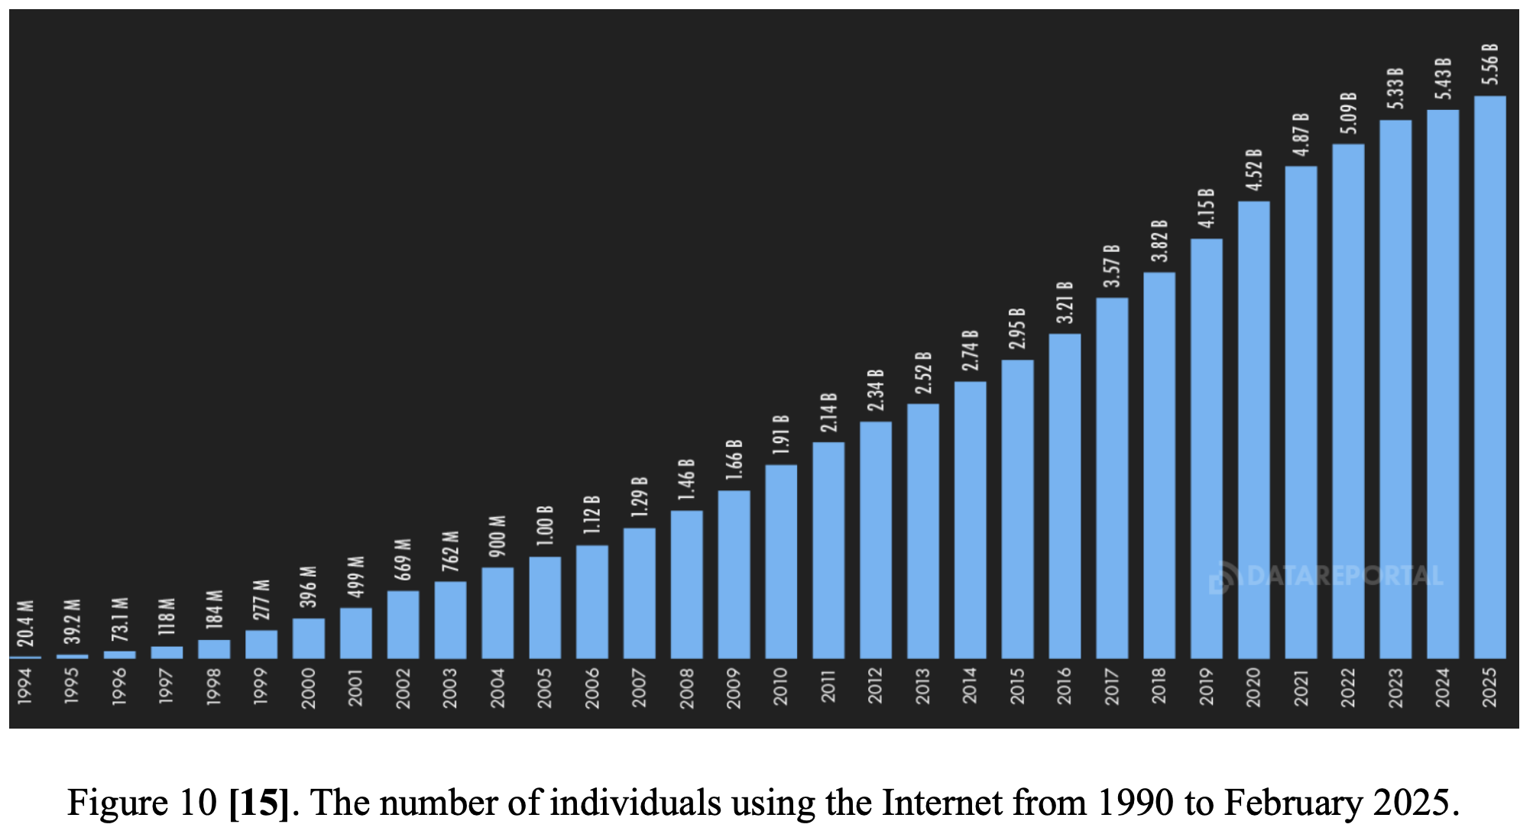

Slide 43

Conclusion & Discussion

Slide 44
Conclusion & Discussion
Cornerstone protocol for modern networks
Disadvantageous due to the current network implementation
Rethink about network infrastructure.

Slide 45

Thank you

